Slide 1


Course 5 – Week 2
Assignment by Jordon Taylor

Slide 2

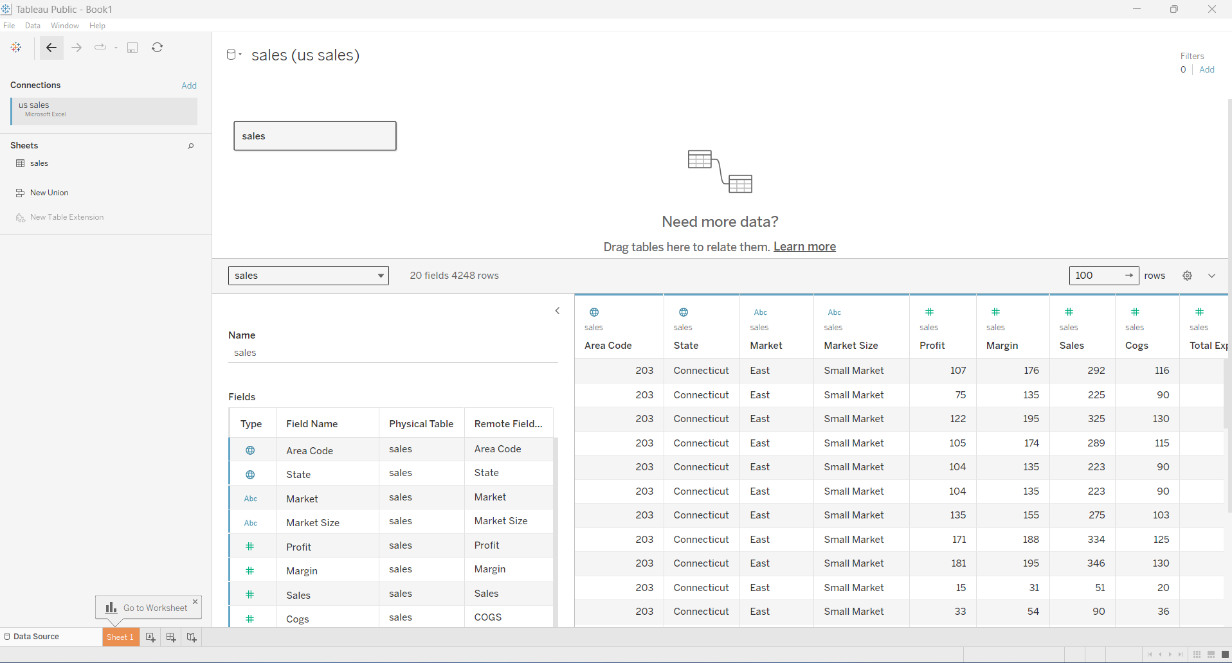
Data Source imported in Tableau

Slide 3
Data Cleaning Process in Excel
In reviewing the dataset for my analysis, I conducted a thorough examination of each column using Excel's filter option to ensure data cleanliness. Fortunately, the majority of the data was clean and free from any significant issues. However, one issue that I did encounter was with the date field, where each row had a time value of 0:00. Recognizing that this lack of specificity in the time component could potentially introduce inaccuracies or inconsistencies in the analysis, I decided to remove these time values from the dataset.
By removing the time values, I aimed to standardize the date format across the dataset and eliminate any potential confusion or errors that could arise from inconsistent time values. Additionally, since the time component did not provide any meaningful information for the analysis I was conducting, removing it did not compromise the integrity or validity of the dataset.
Overall, while the dataset was relatively clean, addressing this issue with the time values ensured that the data used for analysis was consistent, accurate, and free from any unnecessary complexities.

